Slide 1
Software Process Models
LECTURE 4

Slide 2
Software Development Methodologies
Structural Development
Incremental Development
Iterative Development
Agile Development
Reuse Oriented Development
To use any of above mentioned development technique, there are various models, called Software Process Models.
For example; Structural development→ Waterfall Model
Incremental & iterative development → Spiral Model or Scrum Model. Agile development → Extreme programming

Slide 3
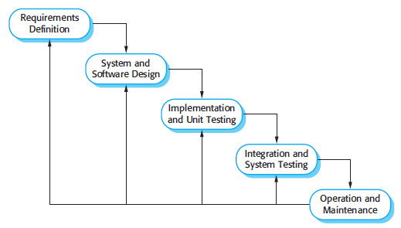
Waterfall Model

Slide 4
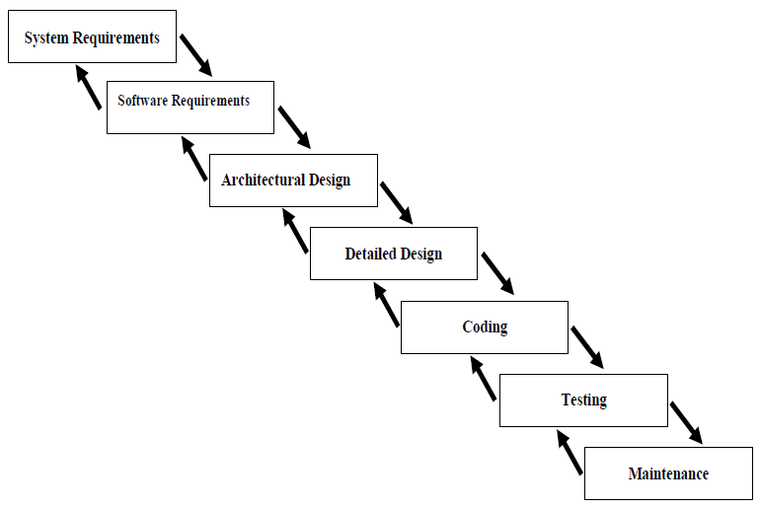
include decisions on
System Requirements: hardware, such as plug-in boards (number of channels, acquisition speed, and so on), and decisions on external pieces of software, such as databases or libraries.
Software Requirements includes determining interaction needed with other applications and databases, performance requirements, user interface requirements.

Slide 5
Waterfall Model Phases
Requirements Definition
  defines needed information, function, behavior, performance and interfaces.
System Analysis & Design
  data structures, software architecture, interface representations, algorithmic details.
Implementation & Unit Testing
  source code, database, user documentation, testing.
Integration & System Testing
  check if all code modules work together and if the system as a whole behaves as per the specifications.
Installation
  deployment of system, user-training.
Maintenance
  bug fixes, added functionality (an on-going process).

Slide 6
Waterfall Model Phases Activities
Requirements Definition:
  Gathering the requirements.
  Techniques: interviews, checklists, surveys, JAD sessions, scenarios, story boards, CRC cards, prototyping, repertory grid, Analyzing existing documents, ethnography.
Requirements Analysis:
  Dependability matrix, SRS Document.
System Design:
  Tools: Conceptual model, logical model, physical models, Relational models, data flow models. Design models.
Testing:
  Types: Unit testing, integration testing, system testing , user acceptance testing (UAT),
  Writing a test plan, writing test cases, implementing test cases.

Slide 7
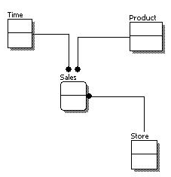
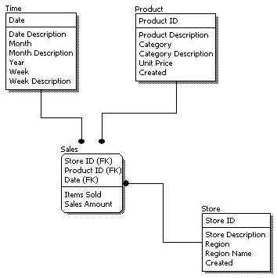
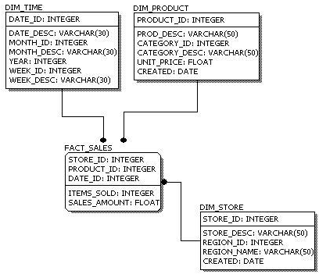
Types of modeling
Conceptual Model
Logical Model
Physical Model
Examples:
Context Model
System Architecture
Block Diagram
Examples:
ERD,
Domain Model
Use Models
System Sequence Diagrams
Class Diagrams
Interaction Diagrams *
Collaboration Diagrams *
Activity Diagrams *
Data Flow Diagrams *
Examples:
Design Class Diagrams
Database Schema
Notes:
*These are used to show the dynamic behavior of system

Slide 8
Waterfall Model
Advantages
Disadvantages
Easy to understand, easy to use
Provides structure to inexperienced staff
Milestones are well understood.
Sets requirements stability.
Good for management control (plan, staff, track)
All requirements must be known.
Deliverables created for each phase are considered frozen – inhibits flexibility
Does not reflect problem-solving nature of software development – iterations of phases
Integration is one big bang at the end
Little opportunity for customer to preview the system (until it may be too late)
If a problem occurs, you can only go back to last phase. But further back is not possible.

Slide 9
Applications of Waterfall Model
Best fit for structural development.
Where the change management is not an issue.
Mostly used for legacy systems because for them, requirements are well understood.
If requirements are likely to be freezed before development, then waterfall model is feasible.

Slide 10
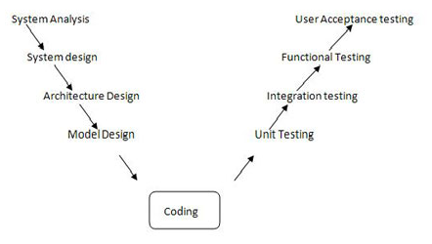
V & V Model
Verification & Validation Model
  A variant of the Waterfall that emphasizes the verification and validation of the product.
  Testing of the product is planned in parallel with a corresponding phase of development
  While the waterfall emphasizes documents and artifacts,
  V model emphasizes activities and correctness

Slide 11
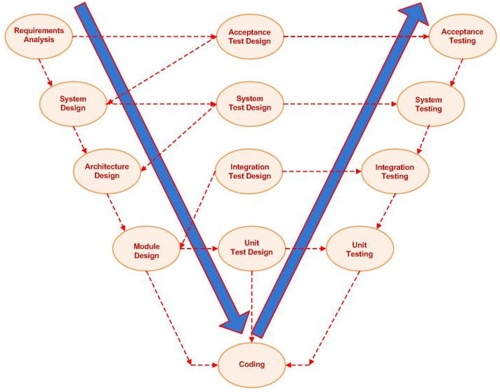

Slide 12
Coping with Change in Requirements
How to manage change in requirements?
Prototyping
Incremental delivery
Spiral Model(Iterative)
RUP

Slide 13
Prototyping
Prototyping
Incremental delivery
Spiral Model(Iterative)
RUP
Prototyping
  A prototype is a partially developed product.
  It enables customers and developers to examine some aspect of a proposed system and decide if it is suitable for a finished product.
  Evolutionary and Throw away prototyping.
Adding prototypes to the life cycle
  Used to explore the risky aspects of the system:
  Risk of developing the “wrong” system (what customer doesn’t want), can be a user interface without functionality
  Other technical risks – e.g. performance, using a new technology, alternative algorithms, etc.
  Can help with the elicitation and validation of system requirements.
Notes:
A software prototype can be used in a software development process to help
anticipate changes that may be required:
1. In the requirements engineering process, a prototype can help with the elicitation
and validation of system requirements.
2. In the system design process, a prototype can be used to explore particular software
solutions and to support user interface design.

Slide 14
Prototyping Steps
Prototyping
Incremental delivery
Spiral Model(Iterative)
RUP
A preliminary project plan is developed
An partial high-level paper model is created
The model is source for a partial requirements specification
A prototype is built with basic and critical functions
The designer builds
  the database
  user interface
  algorithmic functions
The designer demonstrates the prototype, the user evaluates for problems and suggests improvements.
This loop continues until the user is satisfied

Slide 15
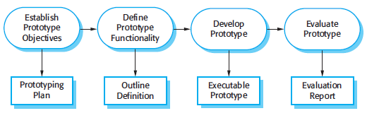
Prototyping Model
Prototyping
Incremental delivery
Spiral Model(Iterative)
RUP

Slide 16
Prototyping Model
Prototyping
Incremental delivery
Spiral Model(Iterative)
RUP
Advantages
Disadvantages
Customers can “see” the system requirements as they are being gathered
Developers learn from customers
A more accurate end product
Unexpected requirements accommodated
Allows for flexible design and development
Steady, visible signs of progress produced
Interaction with the prototype stimulates awareness of additional needed functionality
Tendency to abandon structured program development for “code-and-fix” development.
Bad reputation for “quick-and-dirty” methods
Overall maintainability may be ignored.
Process may continue forever (scope creep)

Slide 17
Application of Prototyping
Requirements are unstable or have to be clarified.
As the requirements clarification stage of a waterfall model.
Develop user interfaces.
When customer is more specific about GUI design.

Slide 18
Incremental Delivery
Prototyping
Incremental delivery
Spiral Model(Iterative)
RUP
  An approach to software development where some of the developed increments are delivered to the customer and deployed for use in an operational environment.
  In an incremental delivery process, customers identify, in outline, the services to be provided by the system.
  They identify which of the services are most important and which are least important to them.
  A number of delivery increments are then defined, with each increment providing a sub-set of the system functionality.
  The allocation of services to increments depends on the service priority, with the highest-priority services implemented and delivered first.

Slide 19
Incremental Model Steps
Prototyping
Incremental delivery
Spiral Model(Iterative)
RUP
  Construct a partial implementation of a total system.
    Customer will prioritize the requirements.
    Complete those requirements.
    Get approval from customer.
  Then slowly add increased functionality
  The incremental model prioritizes requirements of the system and then implements them in groups.
  Each subsequent release of the system adds functions to the previous release, until all designed functionality has been implemented.

Slide 20
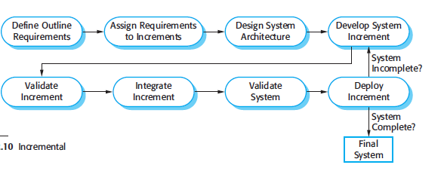
Incremental Model
Prototyping
Incremental delivery
Spiral Model(Iterative)
RUP

Slide 21
Incremental Model
Prototyping
Incremental delivery
Spiral Model(Iterative)
RUP
Advantages
Disadvantages
Develop high-risk or major functions first
Each release delivers an operational product
Customer can respond to each build
Uses “divide and conquer” breakdown of tasks
Lowers initial delivery cost
Initial product delivery is faster
Customers get important functionality early
Requires good planning and design
Requires early definition of a complete and fully functional system to allow for the definition of increments
Well-defined module interfaces are required (some will be developed long before others)
Total cost of the complete system is not lower

Slide 22
Application of Incremental Model
Prototyping
Incremental delivery
Spiral Model(Iterative)
RUP
Most of the requirements are known up-front but are expected to evolve over time.
A need to get basic functionality to the market early
On projects which have lengthy development schedules.
Where Customers are eager to see some progress.

Slide 23
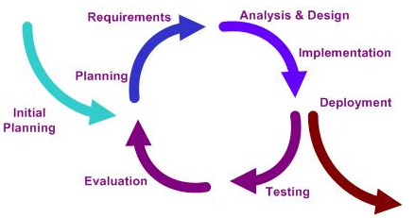
Iterative Model
Prototyping
Incremental delivery
RUP (Iterative)
Spiral Model(Iterative)

Slide 24
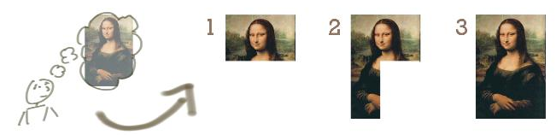
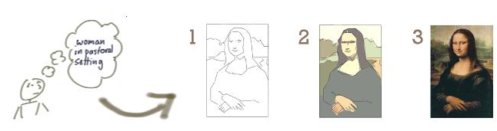
Incremental vs. Iterative
Incremental
Iterative

Slide 25
Incremental vs. Iterative Development
Prototyping
Incremental delivery
RUP (Iterative)
Spiral Model(Iterative)
Incremental
Iterative
Slices the system functionality into increments (portions).
In each increment, a slice of functionality is delivered through cross-discipline work, from the requirements to the deployment.
Incremental development involves breaking a large chunk of work into smaller portions.
This is typically preferable to a monolithic approach where all development work happens in one huge chunk.
Iterative development involves a cyclical process.
While one may still have a general product road map, learning from one iteration informs the next iteration.
This learning can come from end-users, testers, or the developers themselves.
We iterate to find the right solution.
Then given some good candidate solution, we might then iterate to improve a candidate solution.
Notes:
Ref:: http://www.agileproductdesign.com/blog/dont_know_what_i_want.html

Slide 26
Iterative Vs. Incremental process
Incremental development partitions a system by functionality
  Early release starts with small, functional subsystem, later releases add functionality
  Top part of this figure shows how incremental development builds up to full functionality
Iterative development “improves” overall system in each release
  Delivers a full system in the first release, then changes the functionality of each subsystem with each new release
Suppose a customer wants to develop a word processing package
  Incremental approach: provide just Creation functions in Release 1, then both Creation and Organization in Release 2,
  finally add Formatting in Release 3, …
  Iterative approach: provide primitive forms of all three functions in Release 1, then enhance (making them faster, improving the interface, etc.) in subsequent releases
  Pros and cons of these two approaches?
Many organizations combine iterative and incremental approaches

Slide 27
Rational Unified Process (RUP) Model
The unified process groups increments/iterations into phases: inception, elaboration, construction, and transition.
  Inception identifies project scope, requirements (functional and non-functional) and risks at a high level but in enough detail that work can be estimated.
  Elaboration delivers a working architecture that mitigates the top risks and fulfills the non-functional requirements.
  Construction incrementally fills-in the architecture with production-ready code produced from analysis, design, implementation, and testing of the functional requirements.
  Transition delivers the system into the production operating environment.
Each of the phases may be divided into 1 or more iterations.
which are “time-boxed” rather than feature-boxed.
Architects and analysts work one iteration ahead of developers and testers to keep their work-product backlog full.

Slide 28
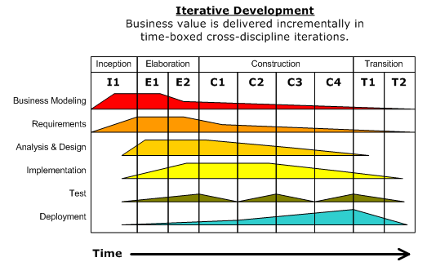
RUP Model
Prototyping
Incremental delivery
RUP (Iterative)
Spiral Model(Iterative)

Slide 29
RUP Advantages
Prototyping
Incremental delivery
RUP (Iterative)
Spiral Model(Iterative)
RUP offered several advantages:
  It provided a well-defined structure for the lifecycle of the project and clearly articulated milestones and decision points
  Focuses on providing value for the user of the system
  Focuses on quality
  It focused on producing working software
  It included evaluation and refinement as a core part of the process
  Iterative and incremental nature.
  Comprised many software development best practices
  It was well-supported with a large user base and extensive documentation

Slide 30
Spiral Model
Prototyping
Incremental delivery
RUP (Iterative)
Spiral Model(Iterative)
Adds risk analysis, and RAD prototyping to the waterfall model
Each cycle involves the same sequence of steps as the waterfall process model .
Consists of 4 quadrants ;

Slide 31
Spiral Quadrant 1
Prototyping
Incremental delivery
RUP (Iterative)
Spiral Model(Iterative)
  Objectives:
  Specific objectives for that phase of the project are defined.
    Functionality, performance, hardware/software interface, critical success factors, etc.
    Constraints: on the process and the product are identified and a detailed management for example: cost, schedule, man-power, experience etc.
    Alternatives: build, reuse, buy, sub-contract, etc.

Slide 32
Spiral Quadrant 2
Prototyping
Incremental delivery
RUP (Iterative)
Spiral Model(Iterative)
  Risk assessment and reduction:
  For each of the identified project risks, a detailed analysis is carried out. Steps are taken to reduce the risk.
    Identify risks (lack of experience, new technology, tight schedules, etc.)
    Resolve risks
  For example, if there is a risk that the requirements are inappropriate, a prototype system may be developed.

Slide 33
Spiral Quadrant 3
Prototyping
Incremental delivery
RUP (Iterative)
Spiral Model(Iterative)
Development and validation:
After risk evaluation, a development model for the system is chosen.
For example,
  throwaway prototyping may be the best development approach if user interface risks are dominant.
  If safety risks are the main consideration, development based on formal transformations may be the most appropriate process, and so on.
  If the main identified risk is sub-system integration, the waterfall model may be the best development model to use.
Typical activities:
    Create a design
    Review design
    Develop code
    Inspect code
    Test product

Slide 34
Spiral Quadrant 4
Prototyping
Incremental delivery
RUP (Iterative)
Spiral Model(Iterative)
Planning :
The project is reviewed and a decision made whether to continue with a further loop of the spiral.
If it is decided to continue, plans are drawn up for the next phase of the project.
Typical activities
  Develop project plan
  Develop a test plan
  Develop an installation plan

Slide 35
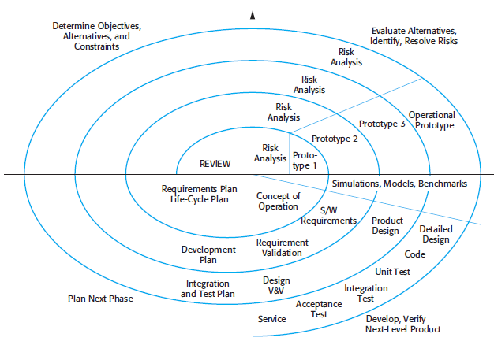
Spiral Model

Slide 36
Applications of Spiral Model
When creation of a prototype is appropriate
When costs and risk evaluation is important
For medium to high-risk projects
Users are unsure of their needs
Requirements are complex
New product line
Significant changes are expected

Slide 37
NOTE
Study the given documents of Iterative Development and comparison of various models in docx and pdf forms respectively.
It is part of your course.
SELF STUDY:
AGILE Process model, Evolutionary process Model

